Slide 1
Radio Antenna Theory
John ‘DaKahuna’ Fulmer
WT6M

Slide 2
Learning Objectives
Antennas - Definition
Antenna Systems
How Antennas Work
Polarization
Radio Frequency
SWR/VSWR
Real Antenna Systems
Notes:
*

Slide 3
Learning Objectives (Cont’d)
Antenna Basics
Other types of Dipoles
Vertical Antennas
Loop Antennas
Directional Beam Antennas
WiFi Antennas
Radiowave Propagation
Notes:
*

Slide 4
Antennas - Defined
An antenna is a piece of metal, a conductor of electricity, to which you connect the radio.
It radiates your signal and receives the signals you want to hear.
Source: http://www.hamuniverse.com/basicantennas.pdf
Notes:
Antennas were originally called aerials. Literally long piece or pieces of wire strung between two trees or towers/poles.
It was assumed that the longer was better. This has been proven to be a flawed philosopy, many of us still believe there is some merit to this belief. (long wires, more surface for receiving signals)
Originally it was thought that there was some mysterious medium that filled all space (the Force??) and that is how an antenna transmitted or received. Today knowing how radio frequencies radiate has lead to the development of highly directional and specialized antennas used for world wide communications.
Despite all of the technical advances there are many of us that still practice the method of calculate your measurments, try it out and then cut/trim as necessary to get it right.
*

Slide 5
Antenna Systems
An antenna system consists of the antenna, the feed-line, and any matching unit. Most antennas are made of copper or aluminum, while most mobile antennas are made of stainless steel. A feed-line consists of two conductors that carry the signal to and from the radio and to and from the antenna. A matching unit can be an antenna tuner, a series matching section, or one of several different kinds of matching circuits at the feed-point.
Source: http://www.hamuniverse.com/basicantennas.pdf
Notes:
*

Slide 6
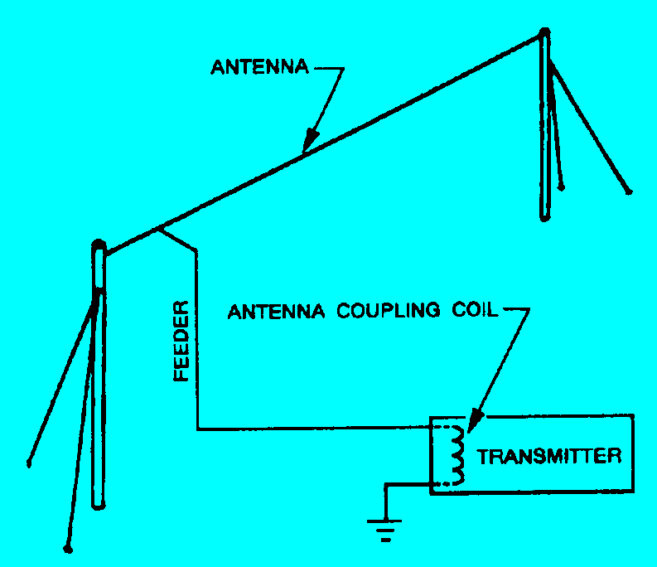
Antenna System (Cont’d)
Notes:
There are three main components to an antenna system:
Coupler - efficient transfer of rf energy between transmitter/receiver and antenna
Feeder – carries rf energy to antenna (coaxial cable, open wire)
Antenna – radiating or receiving part of antenna
*

Slide 7
How Antennas Work
Antenna Systems Must Match Transmitter
Prune length
Antenna tuner
Matching Section
Electromagnetic Fields
Direct Current
Alternating Current
Notes:
The purpose of an antenna is to radiate the energy produce by the transmitter and to receive RF energy and transfer it to the receiver. To best do this the antenna impedance must match the impedance of the transmitter/receiver which is ~50 ohms.
Simple half wave dipoles normally eliminate the need for complex matching systems because their impedance is close to 50 ohms.
*

Slide 8
Polarization
Refers to the manner in which electromagnetic waves travels from the antenna
Horizontal
Vertical
Circular
Notes:
An antenna that runs parallel to the earth generates a horizontal pattern
An antenna that runs vertical to the earth generates a vertical pattern
An antenna that slants from vertical towards horizontal generates components of both horizontal and vertical radiation.
Circular polarization is created when crossed wires connected using proper phasing lines shift the phase from one wire to the other by 90 degrees.
Ideally High Frequency antennas use horizontal polarization. This produces strong high angle radiation which works best for short distance communication. In order to get a strong low angle radiation pattern you would have to put the antenna higher than one wavelength. This is problematic at lower frequencies where 1 wavelength is 140 feet for 7.5 Mhz (40 Meters); 70 feet for 14Mhz (20 meters). This means that vertical antennas work work better on High Frequency bands for stations over 500 miles away unless the horizontal antenna can be mounted hight up.
*

Slide 9
Radio Frequency
Can best be described of as the number of times the polarity an alternating current voltages changes in one second.
Household electricity is 60 Hz
Frequency | Frequency Range
Extremely Low Frequency | 3 Khz - 30 Khz
Very Low Frequency | 30 Khz - 300 Khz
Low Frequency | 300 Khz - 3 Mhz
High Frequence | 3 Mhz - 30 Mhz
Very High Frequency | 30 Mhz - 300 Mhz
Ultra High Frequency | 300 Mzh - 3 Ghz
Super High Frequency | 3 Ghz - 30 Ghz
Notes:
Here are the common frequencies used for communications
For comparison the frequencies range of a standard piano keyboard is 27.5 hz to 4186.01 hz. The human hearing range is 20 hz to 20,000 hz (20Khz)
ELF is used for communications with deeply submerged submarines
VLF and LF are used for radio navigation, time signals and communications with submarines near the surface
HF is used for long haul communications
VHF and UHF are used for short haul communications and some satellites, long haul communications can be achieved with frequencies at the lower end of the range, e.g. HAM Radio operations use 6 Meters (50 - 54 Mhz in the US) for long range communications as well as specialized used such as tropospheric scatter and meteor showers.
SHF is used predominantly for satellite and microwave communications
*

Slide 10
Determining Antenna Lengths
High Frequency Ground Plane
243/F(MHZ) = ¼ wave length in feet
Frequency (Mhz) | ¼ Wave Length (feet) | ½ Wave length (feet)
3.9 | 60 | 120
7.15 | 32 | 65
14.200 | 16 | 32
21.2 | 11 | 22
28.5 | 8 | 16

Slide 11
Determining Antenna Lengths (cont’d)
Wifi Frequency Ground Plane
(243/F(MHZ))*12 = ¼ wave length in inches
Frequency (Mhz) | ¼ Wave Length (inches) | ½ Wave length (inches)
2400 - 2500 | 1.2 | 2.4
5250 – 5350 | 0.5 | 1
Notes:
300/F(MHZ) = ¼

Slide 12
Voltage Standing Wave Ratio (VSWR)
The ratio of maximum voltage to minimum voltage on a transmission line is called the voltage standing wave ratio (WVSR) which is commonly shortened to SWR.
Maximum transfer of energy happens when the SWR ratio is 1:1 (100 Volts max, 100 volts min)
Modern transmitters have protection circuits which typically decreate power when SWR exceeds 2:1 (200V to 100V).
Loss in the transmission line (feedline) can affect SWR readings. If all the forward and reflected voltage is absorbed the SWR reading would be 1:1
Notes:
SWR results when there is an imperfect match between the feedline and the antenna.
Waves traveling toward the radiating part of the antenna meets waves being reflected back down the feed line.
These waves will interfere with each other at certain points along the feedline

Slide 13
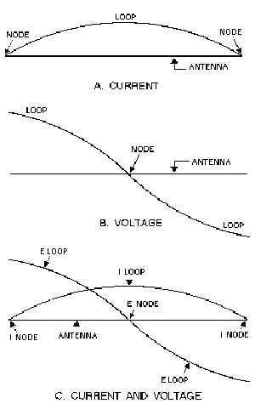
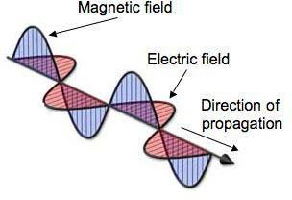
Radiation of Electromagnetic Energy
Notes:
As we saw earlier electromagnetic radiation from an antenna is made up of two components, the E (electric) field and the H (magnetic) field. These two fields occur 90 degrees out of phase with each other. Added together these two fields make up a single electromagnetic field. Except for some absorption by the earth the total energy in the radiated wave remains constant in space. As the distance from the antenna increases the energy of the wave decreases.
Radio waves travel along the wire at a rate of approximately 300,000,000 meters per second. The length of an antenna must be such that a wave will travel from one end to the other and back during the period of 1 cycle of rf voltage. This is known as wavelength. The wavelength is found by dividing the rate of travel by the frequency. i.e. 300M/50Mhz = 6 meters
As we see here, the maximum movement of electrons is in the center of the antenna at all times. This means the center of the antenna is a low impedance point. A node is a low point and a loop is a high point for both current and voltage.
*

Slide 14
Current-Voltage Relationship
Source: http://www.brightbell.com/antenna/antenna1.html

Slide 15
Antenna Basic
Antenna Gain & Loss
Impact antenna has on signal amplitude
Gain
RF Amplifier
Directionalization
Loss
Cable loss
Attenuation in path
Physical
Environmental

Slide 16
Common Units of Measure
Effective Isotopically Radiated Power (EIRP)
Amount of theoretical power radiated by an isotopic antenna
Milliwatt (mW)
One thousanth of a watt
KiloWwatt (kW)
One thousand watts

Slide 17
Power/Gain Measurements
Done in Decibels (logarithmic) scale
+1 Db 1.3 times power
+3Db 2 times power
+6Db 4 times power
+10 Db 10 times power
+13 Db 20 times power
+20 Db 100 times power
+26 Db 400 times power
500 mW with +3 dB antenna = 1000 mW
500 mW with +3 dB annenna + -3 dB cable = 500 mW

Slide 18
Power/Gain Measurements
Some examples
200 mW card + 3 dBi antenna =
200 mW card + 9 dBi antenna =
100 mW card + 3 dBi antenna =
100 mW card + 10 dBi antenna =
320 mW card + 2 dBi antenna =
320 mW card + 5 dBi antenna =
400 mW EIRP
1200 mW EIRP
200 mW EIRP
1000 mW EIRP
500 mW EIRP
1000 mW EIRP

Slide 19
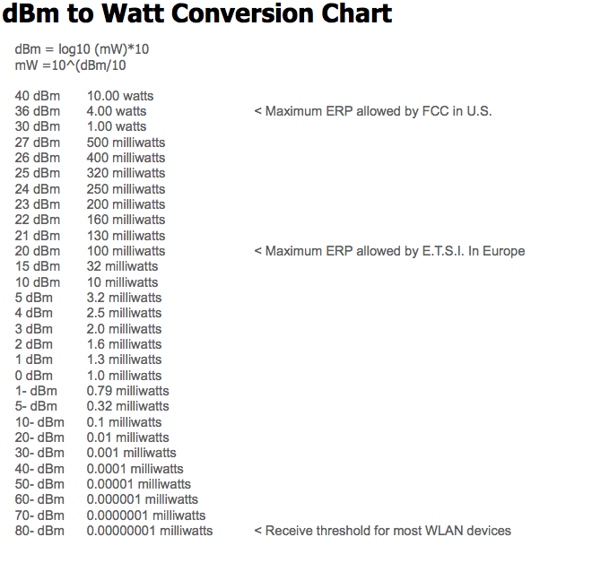
Decibles

Slide 20
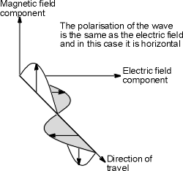
Antenna Characteristics
Reciprocity of Antennas
Antenna Gain
Antenna Polarization
Notes:
Antennas can be defined as a conductor or a group of conductors used either for transmitting or receiving electromagnetic energy. As previously mentioned, common practice today is to use the same antenna for both transmit and receive, assuming the transmit and receive frequencies are the same.
In general the various properties of an antenna apply equally whether transmitting or receiving. For example directive properties of a transmitting antenna will apply as well when the antenna is used for receive purposes. This is knows as reciprocity.
Likewise, any gain exhibited by an antenna will also apply equally to both transmit and receive.
There are three standard antenna polarities – Circular, horizontal and vertical. The maximum amount of electrical energy transfer takes place when both the transmit and receive antennas are oriented in the same direction.
*

Slide 21
Types of RF Antennas
Omni-Directional
Most common time
Radiates equally in all directions
Semi-directional
Radiates stronger signal in multiple directions
Highly-Directional
Radiates stronger signal in one direction

Slide 22
Real Antenna Systems
Half-Wave Flat-top Dipole
source: http://www.hamuniverse.com/n4jaantennabook.html
Notes:
A perfect antenna would radiate 100% of the transmitted power without any tuner.
The half wave dipole is considered the simplest antenna to construct.

Slide 23
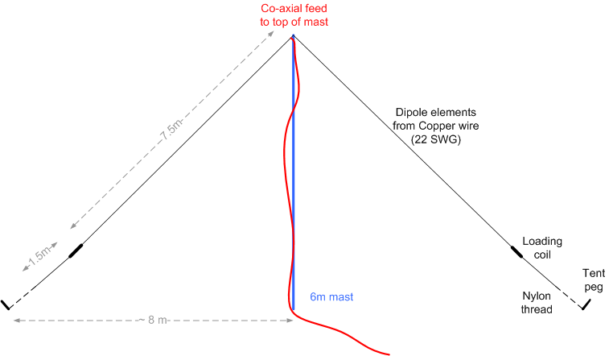
Real Antenna Systems
Inverted-V Dipole
source: http://homepage.ntlworld.com/rossjwilkinson/g6gvi/sixty.html
Notes:
Dropping the legs of diapole into an inverted V shape has two effects
Reduce the feed point impedance to more closely match 50-ohms
Helps to lower the takeoff angle of the radiated signal.

Slide 24
Directionality vs Wave Length
Source: http://www.brightbell.com/antenna/antenna1.html
Notes:
½ wave dipole
3/2 wave lengths
Large multiple of half wave lengths
½ wave length with reflector
½ wave length with reflector and director

Slide 25
Other Dipole Antannas
Trap Dipole
Source: http://www.brightbell.com/antenna/antenna1.html

Slide 26
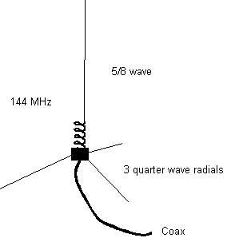
Vertical Antennas
Trap Vertical
Source: http://www.brightbell.com/antenna/antenna1.html

Slide 27
Vertical Anteannas
Vertical with ground plane
Source: http://www.erh.noaa.gov/gyx/nwrhist.html

Slide 28
Loop Antennas
Notes:
1.3 meters can be used for 10kHz to 30Mhz
Benefits of a loop antenna:
Good immunity to electrical noise
Very broadbanded
Has predictable performance
Good response to high angle and low angle long distance communications

Slide 29
Directional Beam Antennas
Yagi-Uda Anteanna

Slide 30
Directional Beam Antennas (cont’d)
Cubical Quad Antenna

Slide 31
Directional Beam Antennas (cont’d)
Rotatable Log Periodic Antenna

Slide 32
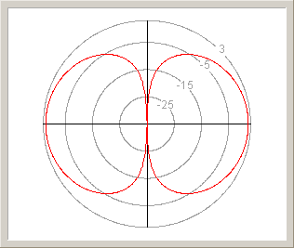
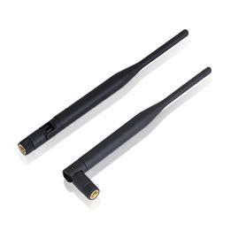
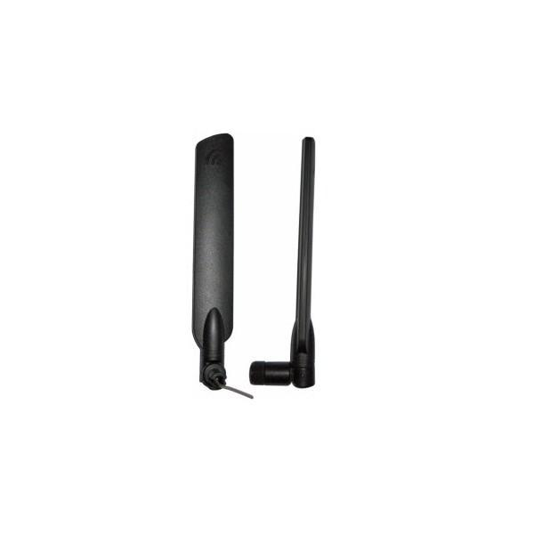
Omni Directional WiFi Antennas
Radiates equally In all directions
Non-discriminating

Slide 33
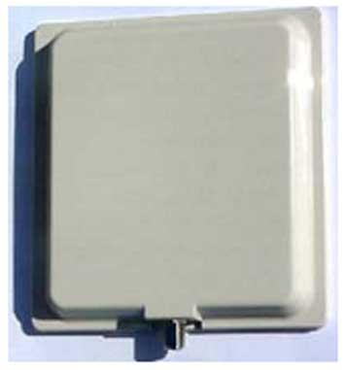
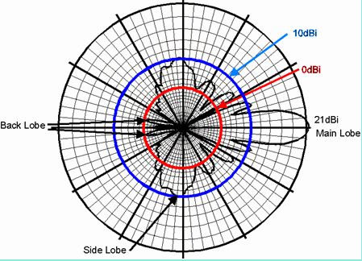
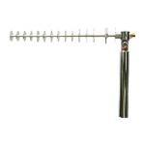
Semi-Directional WiFi Antennas
Radiates stronger signal in multiple directions

Slide 34
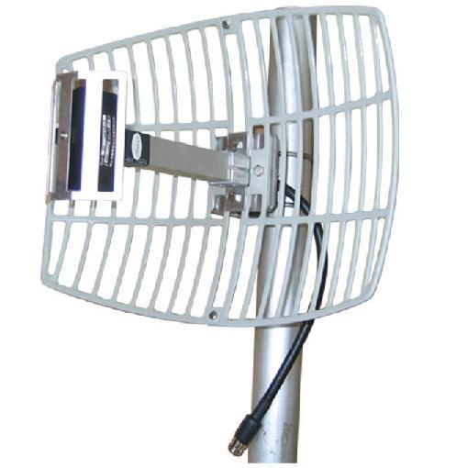
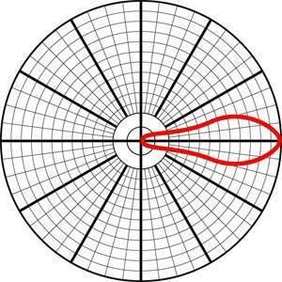
Highly Directional WiFi Antennas
Radiates strong signal in a signal direction

Slide 35
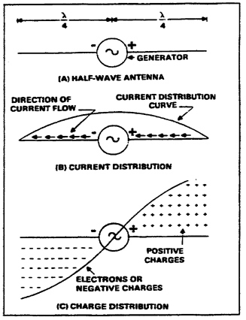
Principles of Radiation
Current and Voltage Distribution on an Antenna
Notes:
To explain this lets use the following scenario.
In View (A) we take a length of wire and cut it exactly in half. We then place a high-frequency generator and set it so that each half of the wire is ¼ wavelength of the output. This would be known as a dipole antenna.
At a given point in time the right side of the generator is positive and the left side is negative.
Since like charges repel each other electrons will flow AWAY from the negative terminal as far as possible. At the same time they will be attracted to the positive terminal. In general the over all current will be the same over the antenna as a whole but will vary at any given point at any time as shown in view B.
One-quarter cycle after electrons have begun to flow, the generator will develop maximum voltage and the current will decrease to zero. At that exact point in time the condition depicted in view C will exist, a maximum number of electrons will be at the left end of the wire and a minimum number on the right end.
From this we can conclude that:
Current flows in the antenna with the amplitude that varies with generator voltage
A sinusoidal distribution of charge exist on the antenna. Every half cycle the charge reverses polarity.
The sinusoidal variation in charge magnitude lags the sinusoidal variation in current by ¼ cycle.
*

Slide 36
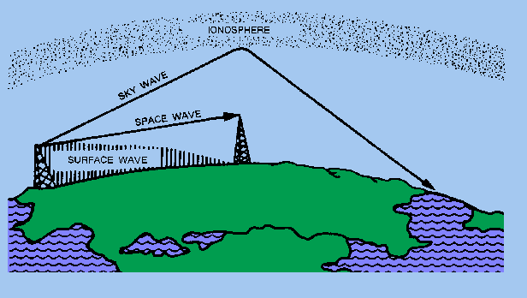
Polarization Requirements for Various Frequencies
Vertical Polarization | Horizontal Polarization
Ground-Wave | Sky-Wave
Advantages of Vertical | Advantages of Horizontal
Notes:
Ground-wave , also called surface wave, is used at medium and low frequencies. Since the earth acts as a fairly good conductor and this permits the radio wave to travel considerable distances along the ground surface with minimal signal loss.
Sky-wave is used at high frequencies. Interestingly enough, either vertical or horizontal polarization can be used for sky-wave transmissions. This is possible because sky-waves are received elliptically polarized as a result of refraction. Horizontal is preferred as it is less likely to be affected by vertically polarized interference from automobile electrical systems and electrical appliance noise.
For frequencies in the VHF and UHF range, either polarization is acceptable because these signals travel directly from transmitting to receiving antenna (line of sight). It is here where it is important that the polarization of the transmitting and receiving antennas be the same.
Vertical antennas are omni-directional which is important for communicating from a moving vehicle. They are best in applications where there are height restrictions and at frequencies under 100Mhz.
Horizontal antennas are bi-directional and are useful to eliminate noise from certain directions. Horizontal antennas experience less loss than verticals when used in areas of dense vegitation or around large buildings. They are best used when frequencies are greater than 100 Mhz
*

Slide 37
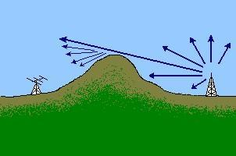
Propagation Characteristics
Diffraction
Bending of ground wave around dense objects
Notes:
Occurs when the ground way ‘bends’ around large/dense objects between the transmitting and receiving antenna.
If the object is large enough, it might block the signal completely.
The lower the frequency the more likely it is to bend rather than be blocked (larger ground wave)
*

Slide 38
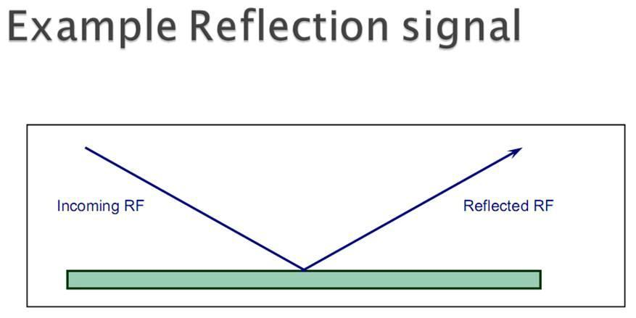
Propagation Characteristics
Reflection
Encountering very dense objects
Notes:
Reflection occurs when signal encounters a large dense object such as the earth, a building, walls, etc.
If the surface is smooth, the signal may have little loss.
Reflection from multiple objects can cause problems with wireless as it may result in the same signal being received multiple times causing cancellation or polarization issues.
*

Slide 39
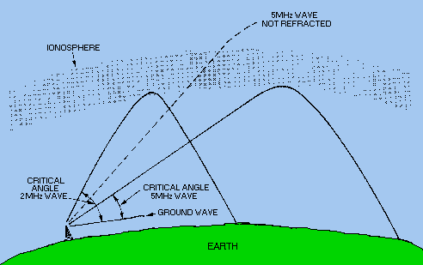
Propagation Characteristics
Refraction
Moving through dense mediums
Notes:
Refraction differs from reflection as the signal is normally ‘bent’ rather than being reflected. This is more prevalent with High Frequency (3 – 30Mhz) than with wireless.
*

Slide 40
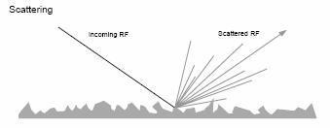
Propagation Characteristics
Scatter
Reflection off uneven surfaces
Notes:
Scattering occurs when a RF signal comes in contact with irregular shaped objects which are small compared to the wavelength of the signal.
Scattering frequently results in a high loss / lower signal strength. With WiFi objects such as trees, electrical, or telephone poles are common objects that cause scattering.
*

Slide 41
Principles of Radiation
Electromagnetic Fields
Importance of Design
Two Basic Types of Antennas
Hertz
Marconi
Antenna Parts
Coupling Device
Feeder
Antenna
Notes:
After the transmitter has generated an RF signal there needs to be a means to radiate this through space to a receiver. An antenna is used to both transmit and receive these signals. While some antennas are designed as transmit or receive only, today most modern antennas serve both purposes.
Design of an antenna is important from the standpoint that the antenna must efficiently transfer the signal. This is more important in transmitting that receiving and transmit antennas must be built to more exact dimensions. For receive antennas dimensions are only critical at low frequencies. As frequency increases, the important of correct dimensions become less critical.
When it comes to transmitting antennas three factors play a role
a. Height of the radiator above earth
b. The conductivity of the earth below the antenna
c. The shape and dimensions of the antenna
Factors that determine the type, size and shape of an antenna are
Frequency
Amount of power to be radiated
General direction of the intended receiver
There are two basic types of antennas – Hertz and Marconi.
A hertz antenna is generally referred to as a half-wave antenna and are generally installed some distance above the ground and are positioned to radiate either vertically of horizontally.
A marconi antenna is generally referred to as a quart wave antenna and operate with one end grounded and are mounted perpendicular to the earth or to a surface acting as a ground.
*

Slide 42
Principles of Radiation
Current and Voltage Distribution
‘Laws’ of radiation of electrometric energy
A moving electric field creates a magnetic field (H)
A moving magnetic field creates an electric field (E)

Slide 43
Polarization Requirements for Various Frequencies
Ground-Wave
Sky-wave
Advantages of Vertical
Advantages of Vertical Polarization
Advantages of Horizontal Polarization
Notes:
Ground-wave is used at medium and low frequencies and uses vertical polarization. Since the earth acts as a good conductor at low to medium frequencies it would short out any horizontal
*

Slide 44
Common Units of Measure
Ampere (amp)
Charge from 6.241 x10¹⁸ electrons in 1 second
Volt (V)
one amp (A) dissipates one watt (W) of power
Decibel (dB)
Relative unit of measure
dB (isotropic) (dBi)
Forward gain of antenna compared to theoretical
Watt (W)
One amp at one volt
Notes:
Isotopic antenna generates RF energy equally in all directions.
*

Slide 45
References
Integrated Publishing Electrical Engineering Training Series
http://www.tpub.com/neets/book10/42
Electronic Communications 3rd Edition
Radio Handbook 23rd Edition
Understanding Antennas For the Non-Technical Ham http://www.hamuniverse.com/basicantennas.pdf

